Slide 1


GPU Programming (in CUDA)
Fall 2018
Julian Gutierrez
Session 7

Slide 2
Outline
Improving Host to Device Memory Transfers
Pinned Memory
Zero Copy
Unified Memory
Concurrency
Dynamic Parallelism

Slide 3
Improving Host to Device Memory Transfers

Slide 4
Memory Transfers
We want to minimize the amount of time it takes to transfer data between host and device.
Device to host memory bandwidth is much lower than device to device bandwidth

Slide 5
Memory Transfers
We want to minimize the amount of time it takes to transfer data between host and device.
How can we do this?
Reduce the amount of data we have to transfer! (if possible)
Achieve highest memory bandwidth between host and device. (Possible when using page-locked (or “pinned”) memory, we are going to talk about it in this session)
Batching many small transfers into one larger transfer performs much better because it eliminates most of the per-transfer overhead
Data transfers between the host and device can sometimes be overlapped with kernel execution and other data transfers (we will talk about this in this session as well)

Slide 6
Memory Transfers
Remember
When deciding whether to run on the GPU or on the CPU, we should consider the kernel execution time and the time it takes to copy data back and forth.
We need to consider the cost of moving data across the PCI-e bus.

Slide 7
Pinned Memory (Page-Locked Data Transfers)
Host (CPU) data allocations are pageable by default.
The GPU cannot access data directly from pageable host memory.
Due to this, Cuda driver must:
Allocate a temporary page-locked block, or “pinned”
Copy host data to the pinned block
Transfer from pinned to device
Delete pinned block
Notes:
To allow programmers to use a larger virtual address space than is actually available in the RAM, CPUs implement a virtual memory system in which a physical memory page can be swapped out to disk.
When the host needs that page, it loads it back in from the disk.
Non-locked memory is stored not only in memory (e.g. it can be in swap), so the driver needs to access every single page of the non-locked memory, copy it into pinned buffer and pass it to the Direct Memory Access (DMA).
PCI-E transfers occur only using the DMA.
A normal transfer consumes precious host time which is avoided when directly using page-locked memory.
Locked memory is stored in the physical memory (RAM), so the GPU can fetch it without the help of the host.

Slide 8
Pinned Memory (Page-Locked Data Transfers)
cudaMallocHost()
Prevents OS from paging host memory
Allows PCI-e DMA to run at full speed
cudaFreeHost()
Allocations can fail so you need to check errors.
malloc
cudaMallocHost
// allocate and initialize
h_aPageable = (float*)malloc(bytes); // host pageable
h_bPageable = (float*)malloc(bytes); // host pageable
checkCuda( cudaMallocHost((void**)&h_aPinned, bytes) ); // host pinned
checkCuda( cudaMallocHost((void**)&h_bPinned, bytes) ); // host pinned
checkCuda( cudaMalloc((void**)&d_a, bytes) ); // device

Slide 9
Pinned Memory (Page-Locked Data Transfers)
You should not over-allocate pinned memory. Doing so can reduce overall system performance because it reduces the amount of physical memory available to the operating system and other programs.
Transfers between the host and device are the slowest link of data movement involved in GPU computing, so you should take care to minimize transfers.

Slide 10
Zero Copy
Access host memory directly from device code
Transfers implicitly performed as needed by device code
All set-up is done on host using mapped memory
Use zero-copy operations on integrated GPUs for CUDA Toolkit version 2.2 and later.
float *a_h, *a_map;
...
cudaGetDeviceProperties(&prop, 0);
if (!prop.canMapHostMemory) exit(0);
cudaSetDeviceFlags(cudaDeviceMapHost);
cudaHostAlloc(&a_h, nBytes, cudaHostAllocMapped);
cudaHostGetDevicePointer(&a_map, a_h, 0);
kernel<<<gridSize, blockSize>>>(a_map);

Slide 11
Zero Copy
Zero copy will always be a win for integrated devices that utilize CPU memory
Zero copy will be faster if data is only read/written from/to global memory once, for example:
Copy input data to GPU memory
Run one kernel
Copy output data back to CPU memory
Potentially easier and faster alternative to using cudaMemcpyAsync.
Some devices use pointers that are 32 bit so there is a limit of 4GB per context.
Note: Mapped pinned host memory allows you to overlap CPU-GPU memory transfers with computation while avoiding the use of CUDA streams. But since any repeated access to such memory areas causes repeated PCIe transfers, consider creating a second area in device memory to manually cache the previously read host memory data.

Slide 12
Unified Memory
In a typical PC or cluster node today, the memories of the CPU and GPU are physically distinct and separated by the PCI-Express bus.
Data that is shared between the CPU and GPU must be allocated in both memories, and explicitly copied between them by the program.

Slide 13
Unified Memory
Unified Memory creates a pool of managed memory that is shared between the CPU and GPU
Managed memory is accessible to both the CPU and GPU using a single pointer
The system automatically migrates data allocated in Unified Memory between host and device
Notes:
so that it looks like CPU memory to code running on the CPU, and like GPU memory to code running on the GPU.

Slide 14
Unified Memory
Unified Memory creates a pool of managed memory that is shared between the CPU and GPU
Managed memory is accessible to both the CPU and GPU using a single pointer
The system automatically migrates data allocated in Unified Memory between host and device
Why do we want this?
Notes:
so that it looks like CPU memory to code running on the CPU, and like GPU memory to code running on the GPU.

Slide 15
Unified Memory
The driver handles the lookup and transfers
Code: CPU and CUDA 6 with UM is basically the same.
Notes:
Its easier to program

Slide 16
Unified Memory
Notice the simplicity
One pointer used by the Host (CPU), and the GPU (kernels)
Notes:
Its easier to program

Slide 17
Unified Memory
Allows Performance through data locality
Data migration happens on demand between CPU and GPU.
Despite this, tuned programs that don’t use UM will perform better due to added complexity in the Driver.
Notes:
Its easier to program

Slide 18
Streams
Cuda stream:
A stream in CUDA is a sequence of operations that execute on the device in the order in which they are issued by the host code.
Operations from different streams can be interleaved
Stream IDs are used as arguments to async calls and kernel launches
Notes:
Notice Async!
Non-blocking command

Slide 19
Streams
Cuda stream:
A stream in CUDA is a sequence of operations that execute on the device in the order in which they are issued by the host code.
Operations from different streams can be interleaved
Stream IDs are used as arguments to async calls and kernel launches
cudaMemcpyAsync
Asynchronous host-device memory copy returns control immediately to CPU
Requires pinned host memory (allocated with cudaMallocHost)
Notes:
Notice Async!
Non-blocking command

Slide 20
Streams
Synchronization
cudaThreadSynchronize()
Blocks until all previously issued CUDA calls from a CPU thread are complete
cudaStreamSynchronize (stream):
Blocks until all CUDA calls issued to given stream have completed.
cudaStreamQuery (stream)
Indicates whether stream is idle.
Doesn’t block CPU thread
CudaStreamWaitEvent (event)
wait for event in a stream

Slide 21
Streams
If we have multiple streams, how many different ways exist to do a complete kernel operation (H2D/Kernel/D2H)?

Slide 22
Streams
If we have multiple streams, how many different ways exist to do a complete kernel operation (H2D/Kernel/D2H)?

Slide 23
Streams
If we have multiple streams, how many different ways exist to do a complete kernel operation (H2D/Kernel/D2H)?

Slide 24
Streams
If we have multiple streams, how many different ways exist to do a complete kernel operation (H2D/Kernel/D2H)?

Slide 25
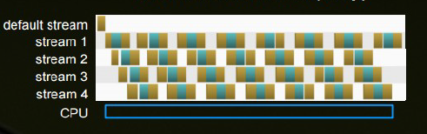
Streams
Example results from a Tiled DGEMM
CPU
43 Gflops
GPU
Serial: 126 Gflops (2.9x)
2-way: 177 Gflops (4.1x)
3-way: 262 Gflops (6.1x)
GPU + CPU
4-way: 282 Gflops (6.6x)

Slide 26
Streams
If we have multiple streams, how many different ways exist to do a complete kernel operation (H2D/Kernel/D2H)?
We need to take into account how many Copy Engines are available!
Lets look at 2 methods on how we could do these operations.
Notes:
GK110 further improves this with the addition of Hyper-Q, which removes the false dependencies that can be introduced among CUDA streams in cases of suboptimal kernel launch or memory copy ordering across streams in Fermi or GK104. Hyper-Q allows GK110 to handle the concurrent kernels and/or memory transfers in separate CUDA streams truly independently, rather than serializing the several streams into a single work queue at the hardware level. This allows applications to enqueue work into separate CUDA streams without considering the relative order of insertion of otherwise independent work, making concurrency of multiple kernels as well as overlapping of memory copies with computation much more readily achievable on GK110.
CUDA streams are automatically mapped onto Hyper-Q's multiple hardware work queues via connections to the hardware allocated by the CUDA Driver. While it is possible to allocate more CUDA streams than there are connections, this simply implies that the driver will alias several streams onto some or all of those connections. The CUDA_DEVICE_MAX_CONNECTIONS environment variable can be used to specify the preferred number of connections to be allocated to the driver. The default is 8 (or fewer if CUDA Multi-Process Service is in use); the architectural maximum for GK110 is 32.
CUDA Multi-Process Service (MPS) presents another means by which applications can take advantage of Hyper-Q, wherein several host processes (typically MPI processes) share access to and submit work to the same GPU concurrently, each process receiving some subset of the available connections to that GPU. Using CUDA MPS, processes can achieve overlap of their respective memory transfers and computations with or without the use of CUDA streams, although at the cost of some added latency of work submission and a few other caveats. For more information see the CUDA MPS Overview[6].

Slide 27
Copy Engines
Method 1

Slide 28
Copy Engines
Method 1
CHD1, K1, CDH1, CHD2, K2, CDH2, …
Queues:
Copy engine
CHD1, CDH1, CHD2, CDH2, …
Kernel
K1, K2, …
Notes:
Imagine all the commands are added to different queues. In reality they are called engines

Slide 29
Copy Engines
Method 2

Slide 30
Copy Engines
Method 2
CHD1, CHD2, …, K1, K2, …, CDH1, CDH2, ….
Queues
Copy Engine
CHD1, CHD2, … CDH1, CDH2, …
Kernel
K1, K2, ….

Slide 31
Copy Engines
When the device has one copy engine

Slide 32
Copy Engines
When the device has one copy engine
Method 1
CHD1, K1, CDH1, CHD2, K2, CDH2, …
Queues:
Copy engine
CHD1, CDH1, CHD2, CDH2, …
Kernel
K1, K2, …

Slide 33
Copy Engines
When the device has one copy engine
Method 2
CHD1, CHD2, …, K1, K2, …, CDH1, CDH2, ….
Queues
Copy Engine
CHD1, CHD2, … CDH1, CDH2, …
Kernel
K1, K2, ….

Slide 34
Copy Engines
When the device has two copy engines
Notes:
This is related to the C2050’s ability to concurrently run multiple kernels. When multiple kernels are issued back-to-back in different (non-default) streams, the scheduler tries to enable concurrent execution of these kernels and as a result delays a signal that normally occurs after each kernel completion (which is responsible for kicking off the device-to-host transfer) until all kernels complete.

Slide 35
Copy Engines
When the device has two copy engines
Method 1
CHD1, K1, CDH1, CHD2, K2, CDH2, …
Queues:
Copy engine
CHD1, CDH1, CHD2, CDH2, …
Kernel
K1, K2, …
Notes:
This is related to the C2050’s ability to concurrently run multiple kernels. When multiple kernels are issued back-to-back in different (non-default) streams, the scheduler tries to enable concurrent execution of these kernels and as a result delays a signal that normally occurs after each kernel completion (which is responsible for kicking off the device-to-host transfer) until all kernels complete.

Slide 36
Copy Engines
When the device has two copy engines
Method 1
CHD1, K1, CDH1, CHD2, K2, CDH2, …
Queues:
Copy engine
CHD1, CDH1, CHD2, CDH2, …
Kernel
K1, K2, …
Added to the other Copy Engine
Notes:
This is related to the C2050’s ability to concurrently run multiple kernels. When multiple kernels are issued back-to-back in different (non-default) streams, the scheduler tries to enable concurrent execution of these kernels and as a result delays a signal that normally occurs after each kernel completion (which is responsible for kicking off the device-to-host transfer) until all kernels complete.

Slide 37
Copy Engines
When the device has two copy engines
Method 2
CHD1, CHD2, …, K1, K2, …, CDH1, CDH2, ….
Queues
Copy Engine
CHD1, CHD2, … CDH1, CDH2, …
Kernel
K1, K2, ….
Notes:
This is related to the C2050’s ability to concurrently run multiple kernels. When multiple kernels are issued back-to-back in different (non-default) streams, the scheduler tries to enable concurrent execution of these kernels and as a result delays a signal that normally occurs after each kernel completion (which is responsible for kicking off the device-to-host transfer) until all kernels complete.

Slide 38
Copy Engines
When the device has two copy engines
Method 2
CHD1, CHD2, …, K1, K2, …, CDH1, CDH2, ….
Queues
Copy Engine
CHD1, CHD2, … CDH1, CDH2, …
Kernel
K1, K2, ….
Added to the other Copy Engine
Notes:
This is related to the C2050’s ability to concurrently run multiple kernels. When multiple kernels are issued back-to-back in different (non-default) streams, the scheduler tries to enable concurrent execution of these kernels and as a result delays a signal that normally occurs after each kernel completion (which is responsible for kicking off the device-to-host transfer) until all kernels complete.

Slide 39
Copy Engines
When the device has two copy engines
Method 2
CHD1, CHD2, …, K1, K2, …, CDH1, CDH2, ….
Queues
Copy Engine
CHD1, CHD2, … CDH1, CDH2, …
Kernel
K1, K2, ….
The D2H engine wont be engaged until all kernels finish
Added to the other Copy Engine
Notes:
This is related to the C2050’s (the one they used for these examples) ability to concurrently run multiple kernels.
When multiple kernels are issued back-to-back in different streams, the scheduler tries to enable concurrent execution of these kernels and as a result delays a signal that normally occurs after each kernel completion (which is responsible for kicking off the device-to-host transfer) until all kernels complete.

Slide 40
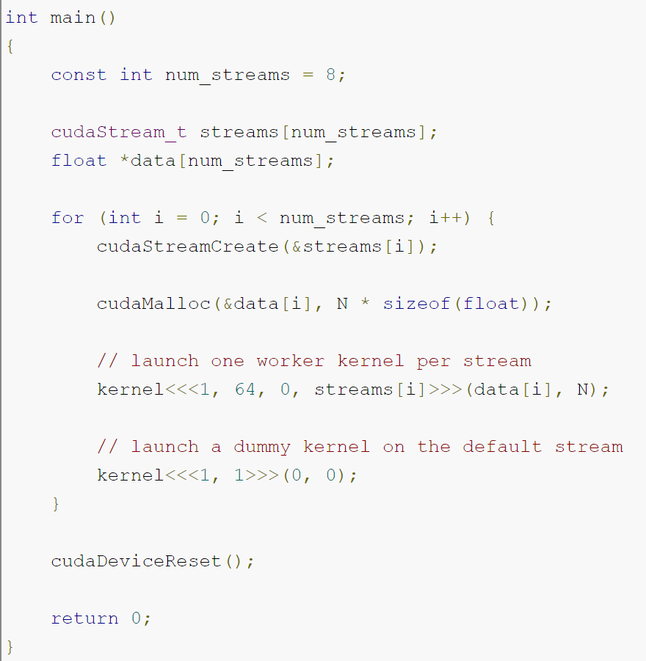
Streams again
Now that we’ve copied data efficiently and overlapped with execution. Another simple example:

Slide 41
Streams again
When you execute asynchronous CUDA commands without specifying a stream:
runtime uses the default stream.
Before CUDA 7, the default stream is a special stream which implicitly synchronizes with all other streams on the device.
CUDA 7 introduces a new option to use an independent default stream for every host thread, which avoids the serialization of the legacy default stream.
--default-stream

Slide 42
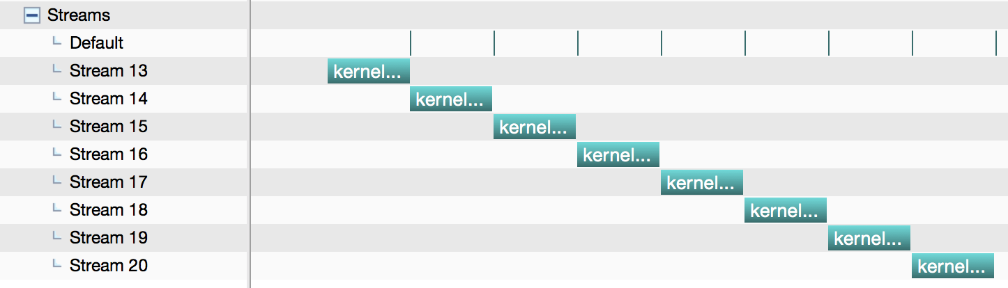
Streams again

Slide 43
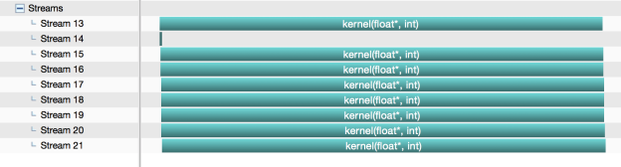
Streams again
-–default-stream per-thread
Notes:
Notice default stream is stream 14 (for dummy kernel call), there are 8 calls there.

Slide 44
Dynamic Parallelism
Device-side kernel launches
Kepler GK110 architecture
Typical use cases
Dynamic load balancing
Data-dependent execution
Recursion
Library calls from kernels
Programmability and maintainability

Slide 45
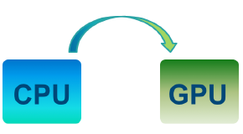

Dynamic Parallelism
Device-side kernel launches
Kepler GK110 architecture
Typical use cases
Dynamic load balancing
Data-dependent execution
Recursion
Library calls from kernels
Programmability and maintainability
Fermi: Only CPU can generate GPU work
Kepler: GPU can generate work for itself

Slide 46
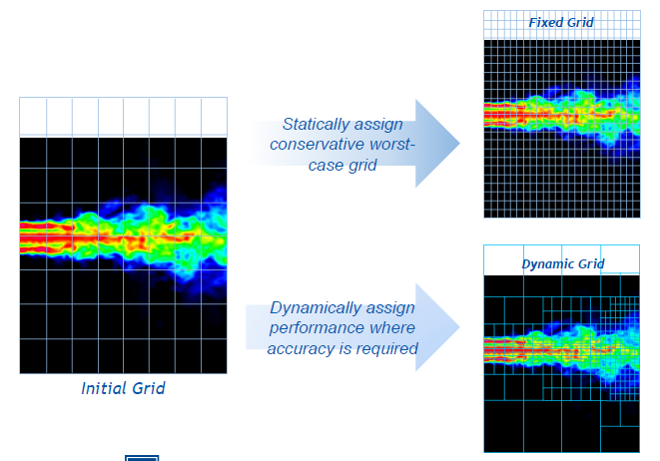
Dynamic Parallelism
Fixed grid vs dynamic grid for a turbulence simulation model

Slide 47
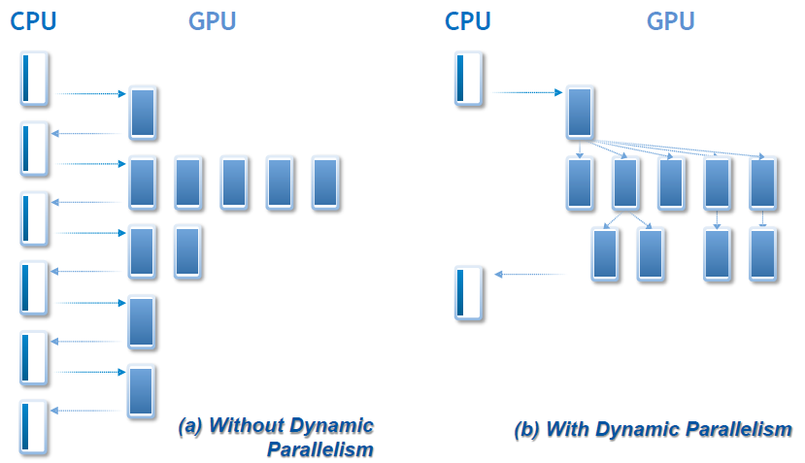
Dynamic Parallelism
CPU-GPU without and with dynamic parallelism

Slide 48
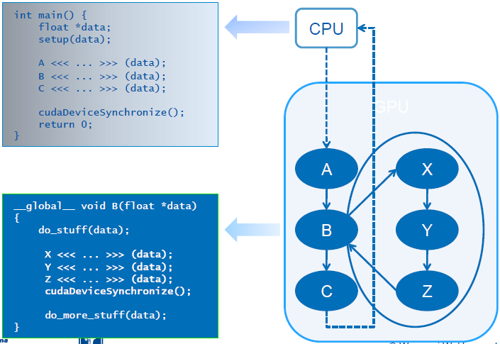
Dynamic Parallelism
Nested dependencies

Slide 49
Dynamic Parallelism
Syntax
Kernel_name <<<Dg, Db, Ns, S>>> ([kernel arguments]);
Dg is of type dim3 and specifies the dimensions and size of the grid
Db is of type dim3 and specifies the dimensions and size of each thread block
Ns is of type size_t and specifies the number of bytes of shared memory that is dynamically allocated per thread block for this call
S is of type cudaStream_t and specifies the stream associated with this call

Slide 50
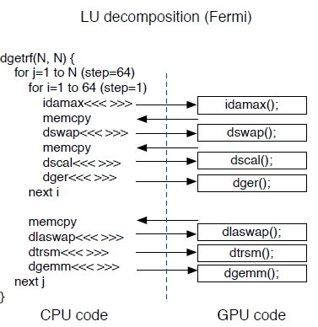
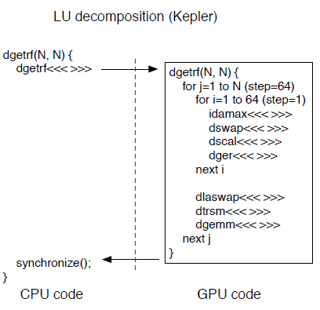
Dynamic Parallelism
Example

Slide 51
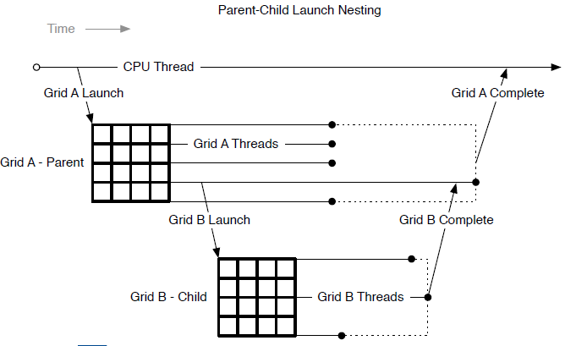
Dynamic Parallelism
Synchronization
Parent to child: memory consistency
Child to parent: after cudaDeviceSynchronize()

Slide 52
Dynamic Parallelism
Memory Model
Child sees parent state at time of launch
Parent sees child writes after sync
Texture changes by child are visible to parent after sync.
Sync == tex cache invalidate
Constants are immutable
Local and shared memory are private

Slide 53
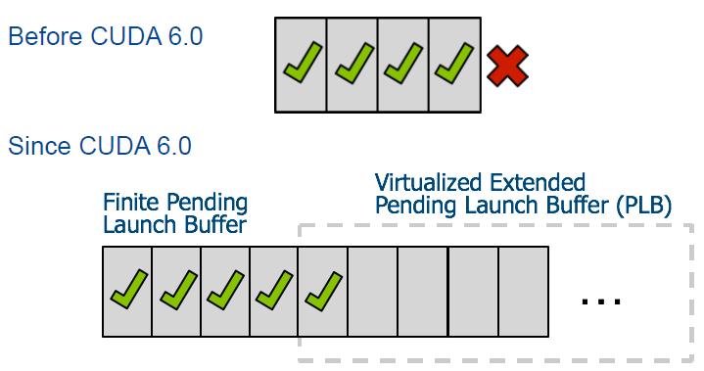
Dynamic Parallelism
Launch pool size
Fixed-size pool: default 2048
Variable-size pool

Slide 54
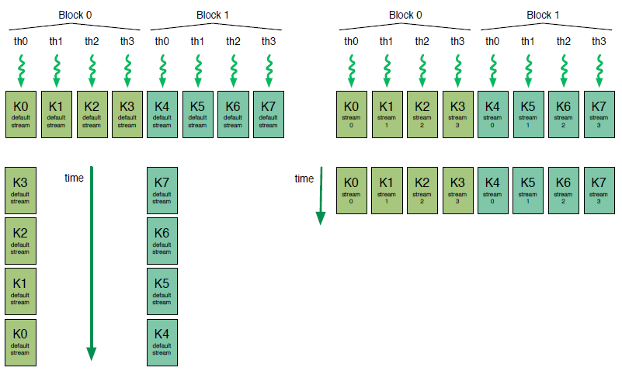
Dynamic Parallelism
Streams
To guarantee concurrency

Slide 55
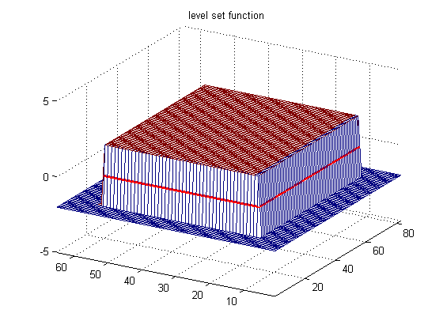
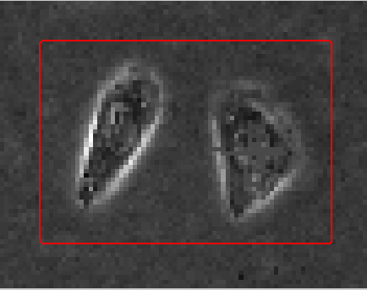
Dynamic Parallelism
Level Set Algorithm
Level Set Methods
Used to detect the border of an object on an image
They use partial differential equations to evolve the curve in the image
Positive = object
Negative = not object

Slide 56
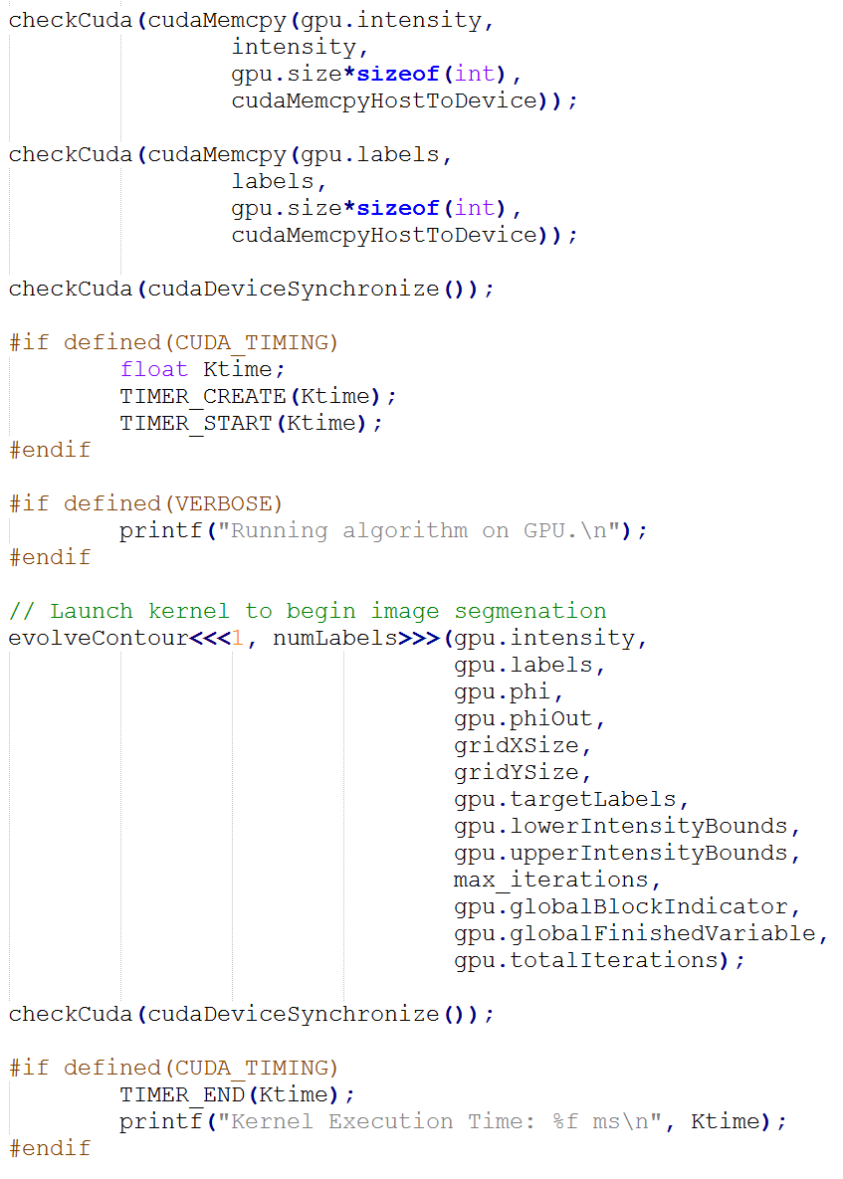
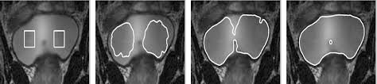
Dynamic Parallelism
Level Set Algorithm Implementation

Slide 57
Dynamic Parallelism
Level Set Algorithm Implementation

Slide 58
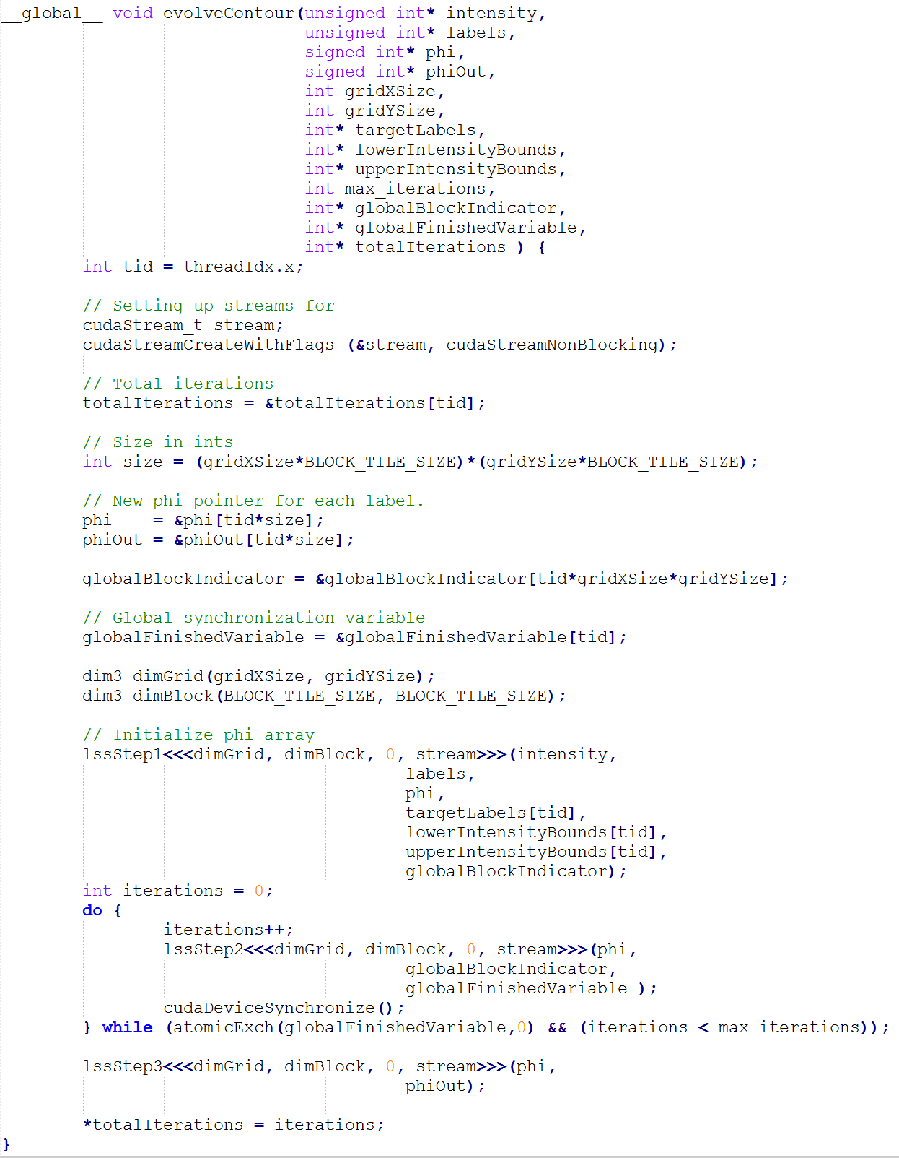

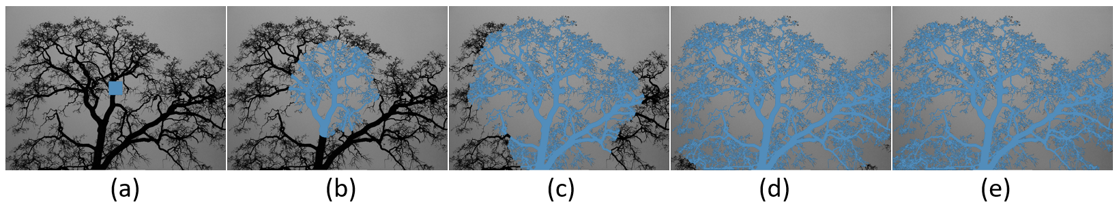
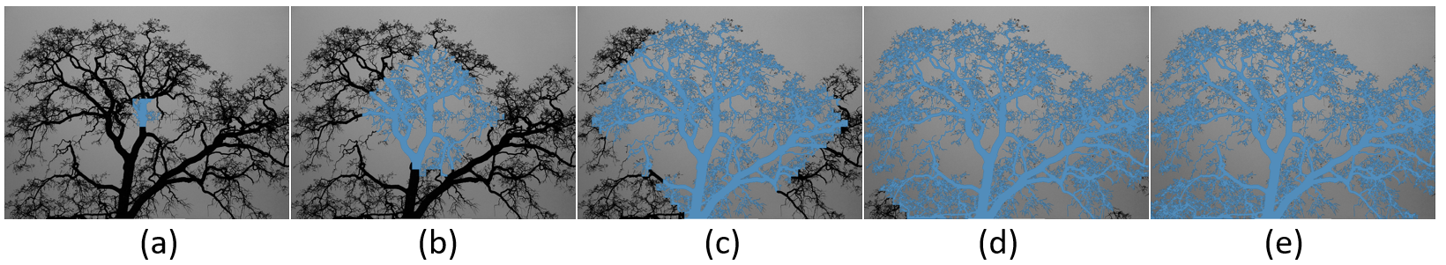
Dynamic Parallelism
Level Set Algorithm Implementation

Slide 59
Dynamic Parallelism
Level Set Algorithm Implementation

Slide 60
Another Recursive Example
To understand recursive usage
Classic Fibonacci series: 0, 1, 1, 2, 3, 5…
CPU Recursive
GPU non recursive nonDP
GPU recursive DP

Slide 61
FIBONACCI – CPU RECURSION
int fib(int n){
if (n == 0 || n == 1 ){
return n;
}
else{
return fib(n-1) + fib(n-2);
}
}

Slide 62
FIBONACCI – GPU PLAIN KERNEL
__global__ void fib_kernel_plain(int n, long int* vFib){
int tid = threadIdx.x + blockDim.x * blockIdx.x;
if (tid > n/32)
return;
if (n == 0 || n == 1){
return;
}
for(int i=tid*32 + 2; i <= n && i < tid*32 + 32; i++){
vFib[i] = vFib[i-1] + vFib[i-2];
}
}

Slide 63
FIBONACCI – GPU RECURSION KERNEL
__global__ void fib_kernel_par_rec(int n, unsigned long int* vFib){
if (n == 0 || n == 1)
return;
fib_kernel_par_rec<<<1, 1>>>(n-2, vFib);
fib_kernel_par_rec<<<1, 1>>>(n-1, vFib);
cudaDeviceSynchronize();
vFib[n] = vFib[n-1] + vFib[n-2];
}

Slide 64
FIBONACCI
Performance CPU vs GPU non DP vs GPU DP
Notes:
Complexity of recursive fibonacci is O(2^n)

Slide 65
FIBONACCI
Performance CPU vs GPU non DP vs GPU DP
Take away?
Notes:
Complexity of recursive fibonacci is O(2^n)

Slide 66
FIBONACCI
Performance CPU vs GPU non DP vs GPU DP
Not suitable for parallel recursion
Notes:
Complexity of recursive fibonacci is O(2^n)

Slide 67
What is and what is not dynamic parallelism
CDP ensures better work balance, and offers advantages in terms of programmability
However, launching grids with a very small number of threads could lead to severe underutilization of the GPU resources
A general recommendation
Child grids with a large number of thread blocks,
Or at least thread blocks with hundreds of threads, if the number of blocks is small
Nested parallelism for tree processing
Thick tree nodes (each node deploys many threads) work well
And/or when branch degree is large (each parent node has many children)
As the nesting depth is limited in hardware, only relatively shallow trees can be implemented efficiently.

